Slide 1

JAXB Tips and Tricks
By
Rob Ratcliff

Slide 2
What is JAXB?
Java architecture for XML binding
Maps an XML Schema into Java Objects
Generates a XML Schema from annotated Java Objects

Slide 3
Top 10 Reasons JAXB is a Fav!
Built into the JDK
Easy to use
Well documented
Logical API
Robust and Efficient implementation
Complete control of the fields that get serialized to XML
Handles mapping from XML Schema or Annotated Java classes
Community generated plugins to customize code generation
Good default mappings
Default mappings can be completely overridden

Slide 4
Java Classes to XML Schema

Slide 5
Converting Java to XML
JAXBContext context = JAXBContext.newInstance(new Class[]{Shape.class, Circle.class, Rectangle.class
Polygon.class, ShapeList.class});
StringWriter stringWriter = new StringWriter();
Marshaller marshaller = context.createMarshaller();
marshaller.setProperty("jaxb.formatted.output", Boolean.TRUE);
marshaller.marshal(jaxbElement, stringWriter);
teturn stringWriter.toString();

Slide 6
Converting XML to Java
StringReader reader = new StringReader(xmlString);
JAXBContext context = getJaxBContext();
ShapeList shape = (ShapeList) context.createUnmarshaller().unmarshal(reader);

Slide 7
Controlling Serialization
Field - @XmlAccessorType(XmlAccessType.FIELD)
All fields are serialized
Property - @XmlAccessorType(XmlAccessType.PROPERTY)
Any property with a getter/setter is seralized
Public field - @XmlAccessorType(XmlAccessType.PUBLIC_MEMBER)
Public getter/setter
Public member
NONE - @XmlAccessorType(XmlAccessType.NONE)
Only serialize the fields explicitly specified with @XmlElement()
@XmlTransient – do not serialize this field

Slide 8
Custom Mapping
Color
Polygons
DateTime
Wrapper Elements

Slide 9
Validating Against a Schema
No validation by default
Just Unmarshaller.setValidating(true) to begin validating

Slide 10
Controlling the Formatting of Generated XML
public String toXML(Object jaxbElement) throws Exception {
StringWriter stringWriter = new StringWriter();
JAXBContext context = getJaxBContext();
Marshaller marshaller = context.createMarshaller();
marshaller.setProperty("jaxb.formatted.output", Boolean.TRUE);
DocumentBuilderFactory docBuilderFactory = DocumentBuilderFactory.newInstance();
Document document = docBuilderFactory.newDocumentBuilder().newDocument();
marshaller.marshal(jaxbElement, document);
Transformer transformer = this.getTransformer();
transformer.transform(new DOMSource(document), new StreamResult(stringWriter));
return stringWriter.toString();
}
Transformer getTransformer() throws Exception {
TransformerFactory transformerFactory = TransformerFactory.newInstance();
Transformer transformer = transformerFactory.newTransformer();
transformer.setOutputProperty(OutputKeys.INDENT, "yes");
transformer.setOutputProperty(OutputKeys.CDATA_SECTION_ELEMENTS, "Notes");
return transformer;
}

Slide 11
Tips
Cache the JAXBContext for much better performance
Use Object version of primitives (Integer, Double, etc) for optional fields (nullable)

Slide 12
Some Useful JAXB Plugins for Customizing Generated Java Classes from XML Schemas
Fluent API Plugin – Generate fluent design pattern for setters
JAXB2 Basics Plugin – generates toString(), equals(), hashcode(), etc.
Value Constructor – generates a constructor with arguments
HyperJAXB3 – Generates JPA annotated classes
See https://java.net/projects/jaxb2-commons/pages/Home for more plugins

Slide 13
Current Deficits
JavaDoc gets lost in translation
No standard way to specify data restrictions with annotations (Bean Validation may help…better if they were built into JAXB…See EclipseLink Moxy)

Slide 14
Questions?

Slide 15
XML Schema to Java Classes
Work in progress….

Slide 16
Converting Java Classes from Schema
xjc geometry.xsd -b geometry.xjb
Binding File
<globalBindings>
[ collectionType = "collectionType" ]
[ fixedAttributeAsConstantProperty = "true" | "false" | "1" | "0" ]
[ generateIsSetMethod = "true" | "false" | "1" | "0" ]
[ enableFailFastCheck = "true" | "false" | "1" | "0" ]
[ choiceContentProperty = "true" | "false" | "1" | "0" ]
[ underscoreBinding = "asWordSeparator" | "asCharInWord" ]
[ typesafeEnumBase = "typesafeEnumBase" ]
[ typesafeEnumMemberName = "generateName" | "generateError" ]
[ enableJavaNamingConventions = "true" | "false" | "1" | "0" ]
[ bindingStyle = "elementBinding" | "modelGroupBinding" ]
[ <javaType> ... </javaType> ]*
</globalBindings>

Slide 17
Generating Java Classes from Schema
xjc -extension geometry.xsd -b geometry.xjb

Slide 18
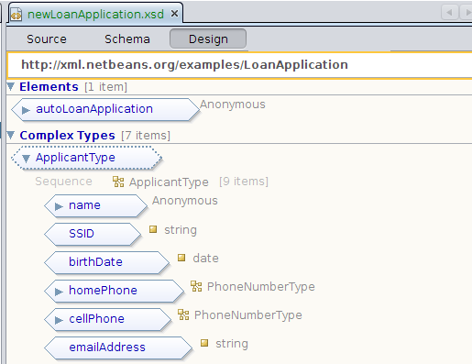
XML Schema Editors
http://deadlock.netbeans.org/hudson/job/xml/lastSuccessfulBuild/artifact/build/updates/updates.xml
http://wiki.eclipse.org/index.php/Introduction_to_the_XSD_Editor

